Slide 1

Cyclistic Analysis
Here is where your presentation begins
Presented by: Andrew Melcer
Last Updated: 17th of November, 2021

Slide 2
Cyclistic
Table of Contents
Objective
Analysis
Recommendations
Conclusion
Here is where your presentation begins

Slide 3
Objective
Identify how members and casual riders differ as well as highlight the advantages that come with a Cyclistic annual membership.
Here is where your presentation begins

Slide 4
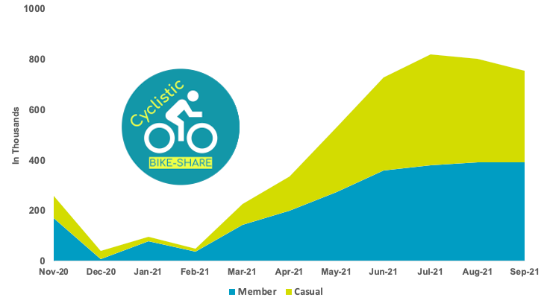
Ride Count
The ride count varies greatly depending on the month
Direct correlation between tourist season and ride count
Warmer months are a strong indicator of higher ride count
Here is where your presentation begins

Slide 5
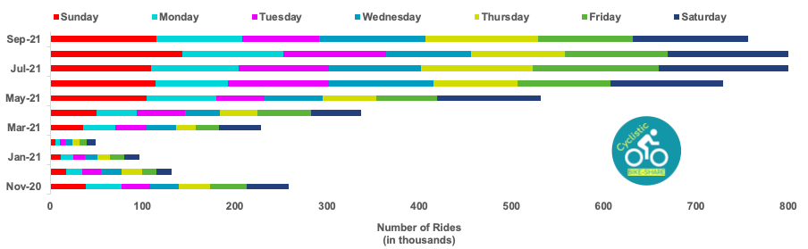
Day of the Week
Friday, Saturday, and Sunday tend to have the most total daily riders, with the winter months having the lowest daily user count
Here is where your presentation begins

Slide 6
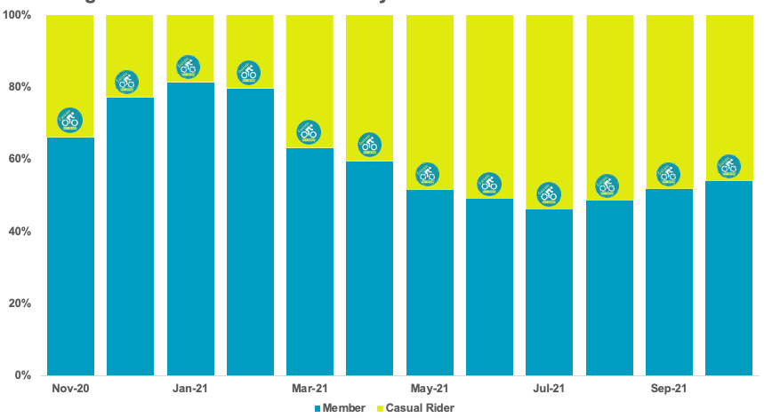
User Breakdown
There is a direct correlation between casual rider usage and warmer months
Here is where your presentation begins

Slide 7
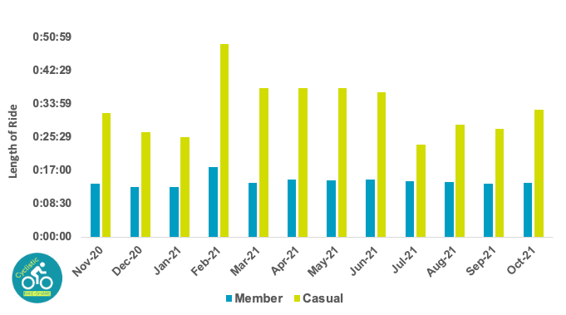
Ride Length
Casual riders have nearly double the average ride length of annual members.
Annual members are consistent with their ride length, regardless of the time of year.
Here is where your presentation begins

Slide 8
Whoa!
With casual riders having a ride length of nearly double that of members, we can use this to our advantage by advertising during peak travel season.

Slide 9
Why do casual riders have nearly double the ride length?
Theory 1
Theory 3
Casual riders are mostly tourists
Casual riders are having difficulty finding a drop off point
Theory 2
Theory 4
Members are using the bikes to commute to and from work
Members have a destination in mind while casual riders do not

Slide 10
Recommendations
Deals
Advertise
Social Media
Create cheaper deals, especially for new or returning casual riders
Advertise these new discounts during peak travel season
Create a social media campaign to grow awareness

Slide 11
Sales funnel
Awareness
Interest
Decision
Purchase
Drum up awareness through targeted social media advertisements
Create eye-catching deals that can be shared easily
Encourage their decision with discounts during summer months
Create new annual memberships instead of one-time casual riders

Slide 12
SWOT analysis
Strengths
Weaknesses
New revenue stream from targeted holiday advertisements
Possible slight losses initially with larger returns annually
Opportunities
Threats
Encourage casual riders to switch over to an annual membership
Pushback from current members missing out on the new deals

Slide 13
Conclusions
Peak tourist season creates more daily users for both annual members and casual riders
Casual riders ride length is nearly twice that of members
Targeted advertisements to casual riders during tourist season will bring in more annual members.

Slide 14
Thanks
Do you have any questions? andrewmelcer@gmail.com +34 653 383 213
Skype: andrewmelcer

